Slide 1
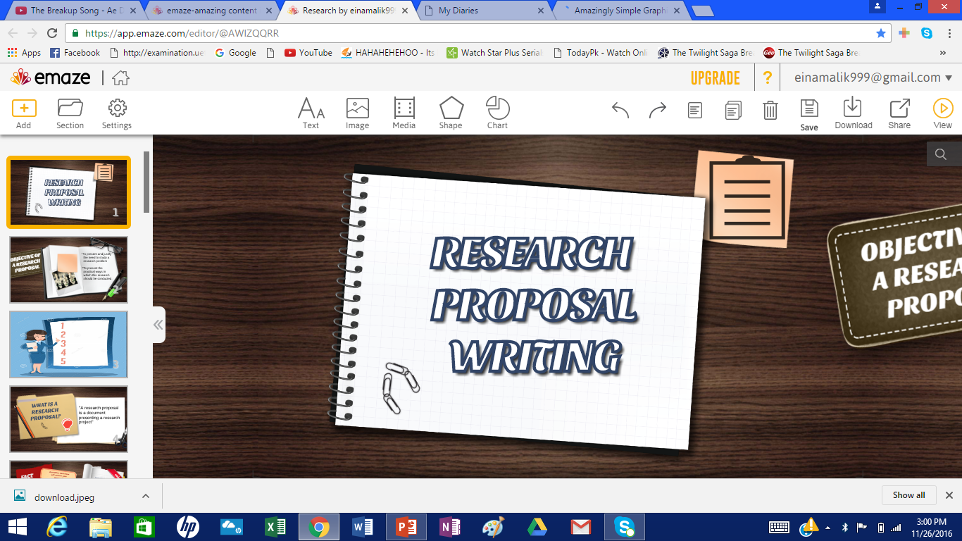

Slide 2

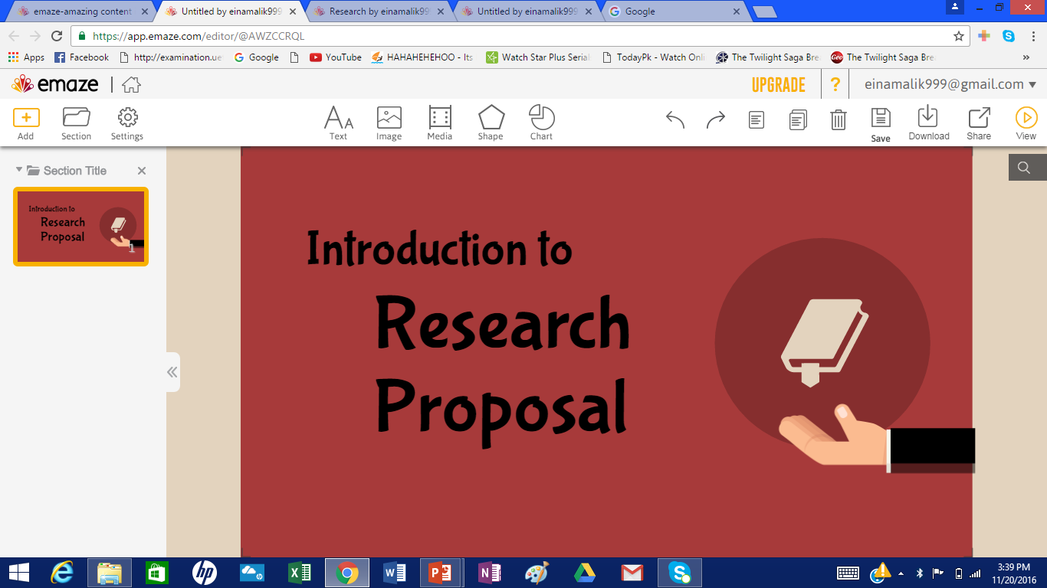

Slide 3

What Is Research Proposal?
A research proposal is a document proposing a research project, generally constitutes a request for sponsorship of that research.

Slide 4

Why do we need Research Proposal?
Organising and developing your topic ideas.
Testing the scope of the research.
Convincing other people of the merit of your idea.
Initiating the research process.

Slide 5

Research Proposal
Internal Research Proposal
External Research Proposal
Academic Research Proposal
Non-Academic Research Proposal
Solicited Research Proposal
Unsolicited Research Proposal
Types Of Research Proposal:
Research Proposal
Internal Research Proposal
External Research Proposal
Academic Research Proposal
Solicited Research Proposal
Un-Solicited Research Proposal
Non-Academic Research Proposal

Slide 6

Internal Research Proposal
They are short.
Up to 1 to 3 page memo, from the researcher to management.
It outlines the problem statement, study objectives, research design, and schedule.

Slide 7


Academic Research Proposal
This type of research is for degree requirement.
It is the first step in producing a thesis.
Its intent is to convince a supervisor or academic committee that your topic and approach are sound.
Non-Academic Research Proposal
This type of research proposal is not for degree requirement by a university or a college teacher to some research organization.

Slide 8
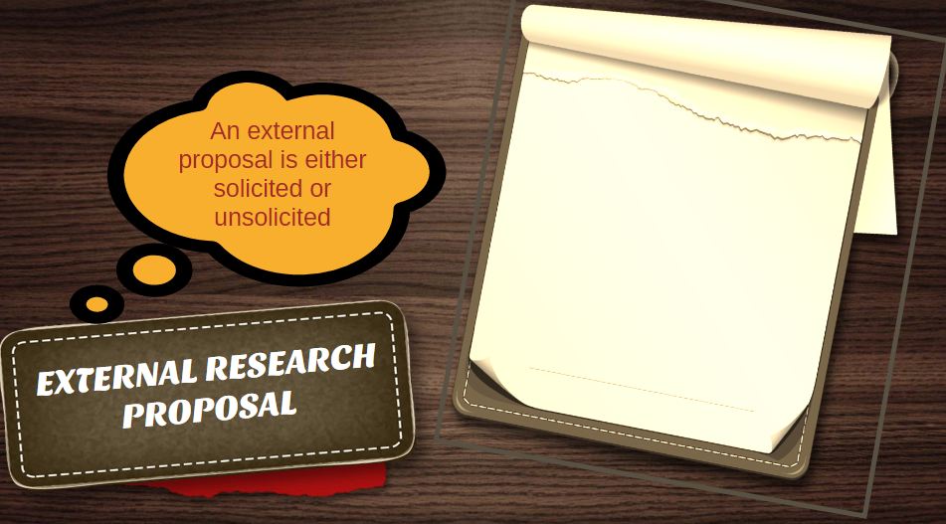
Solicited
Unsolicited
Solicited proposals are those that are written and submitted in response to the issuance of a "Request for Proposals" (RFP).
Unsolicited proposals are those proposals that are submitted by an investigator in response to a "general call" for proposals.

Slide 9

Research Proposal
Research Report
Research Proposal: It is a document proposing a research project
Purpose: It is to collect additional data on the subject matter.
Research Report: It is a document that describes the process, progress or results of technical or scientific research or the state of technical or scientific research problems.
Purpose: It is to educate the audience about a subject.

Slide 10
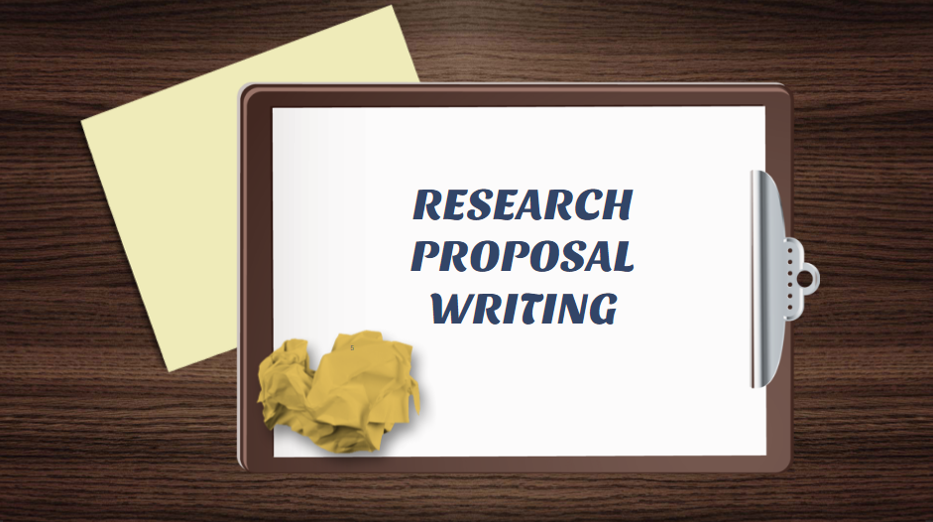

Slide 11
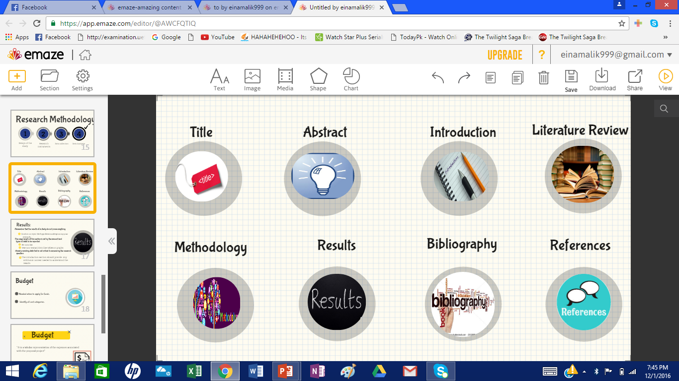

Slide 12
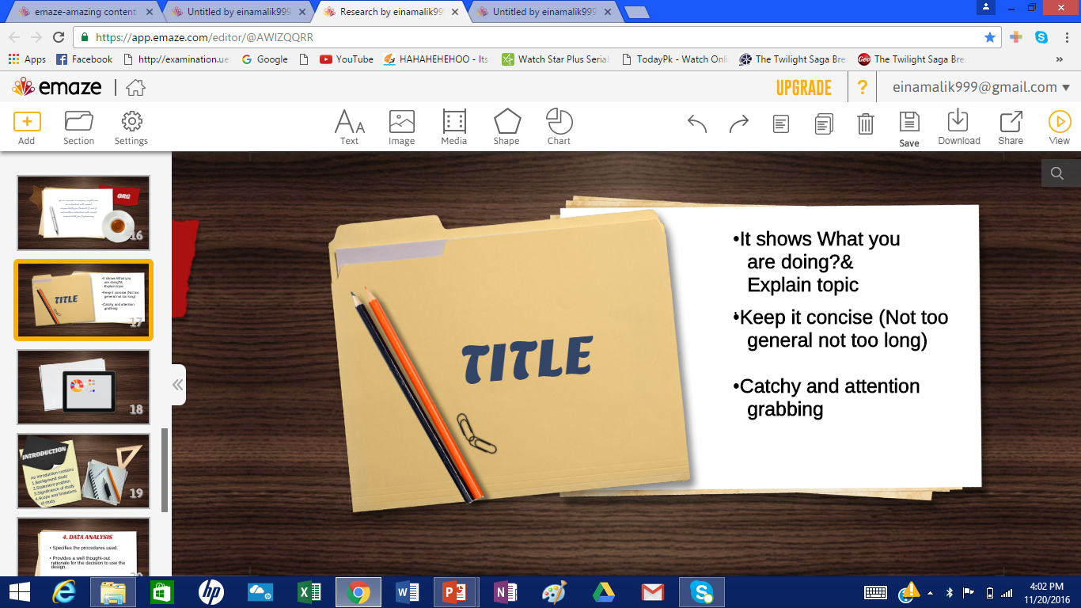

Slide 13
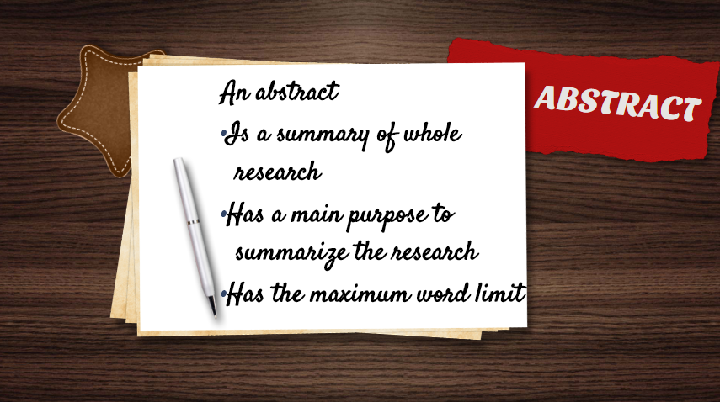

Slide 14
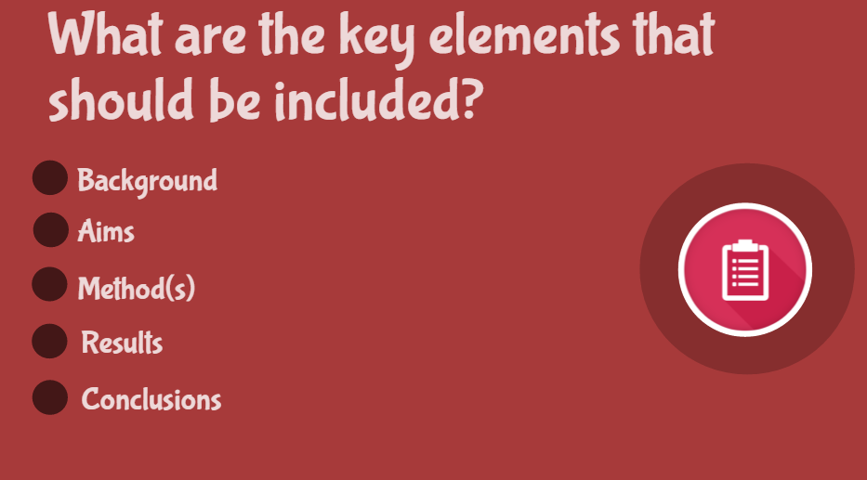

Slide 15
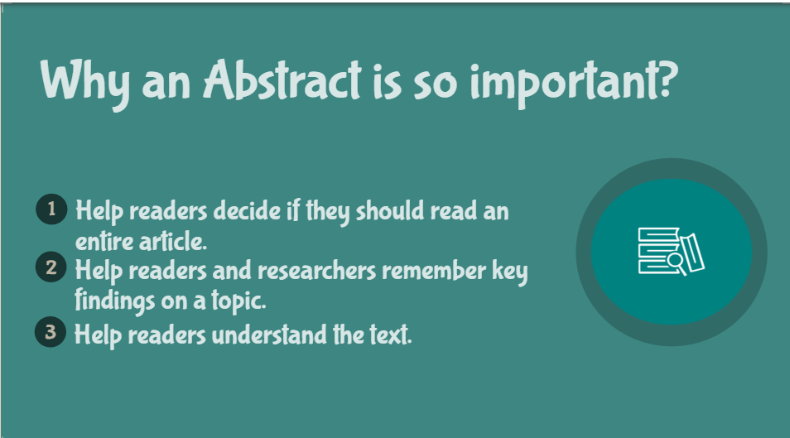

Slide 16
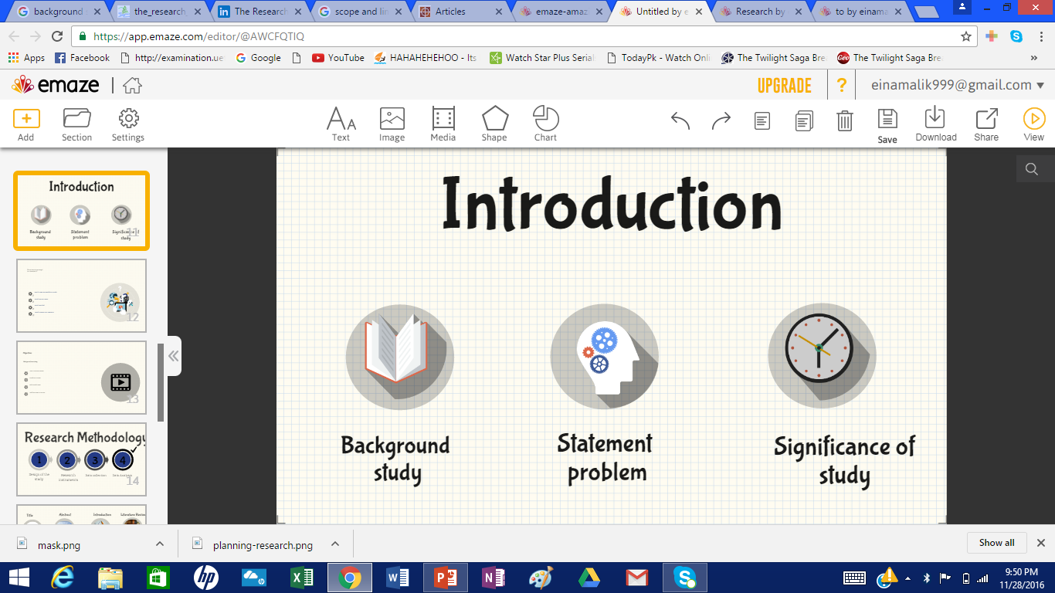

Slide 17
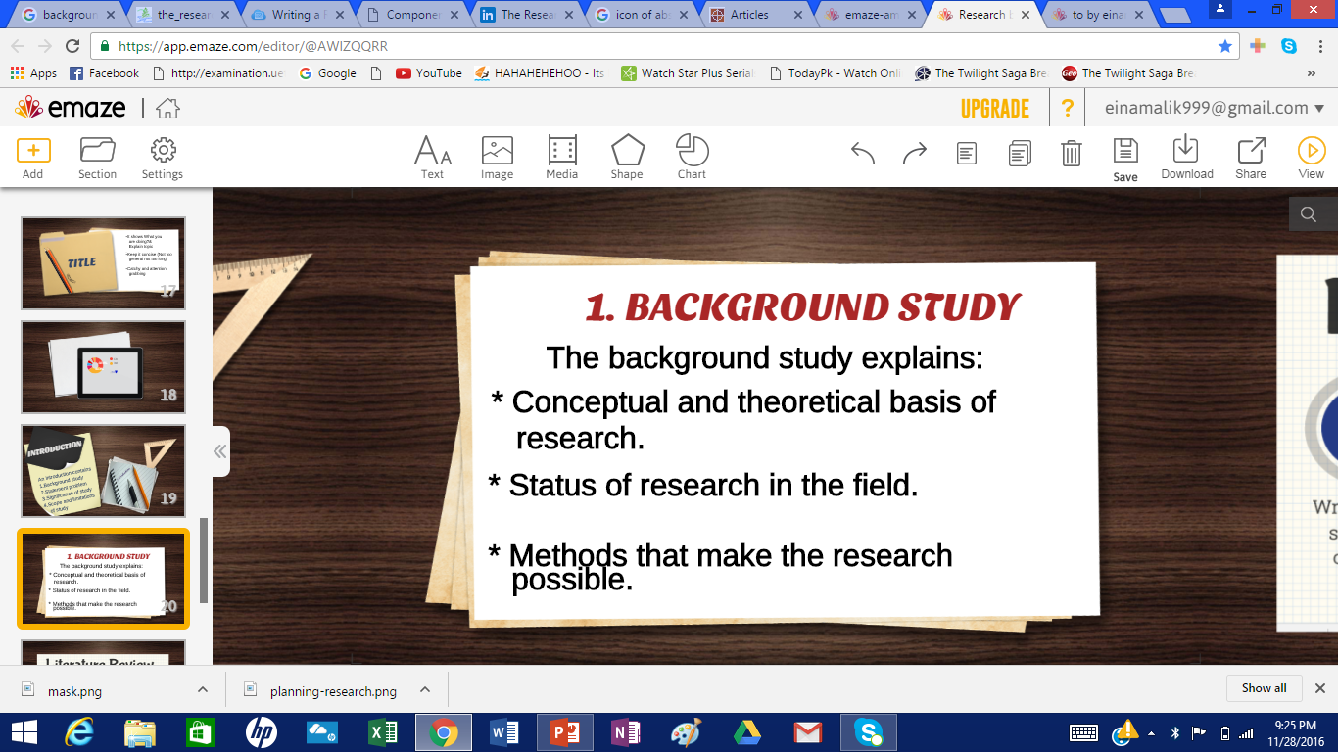

Slide 18
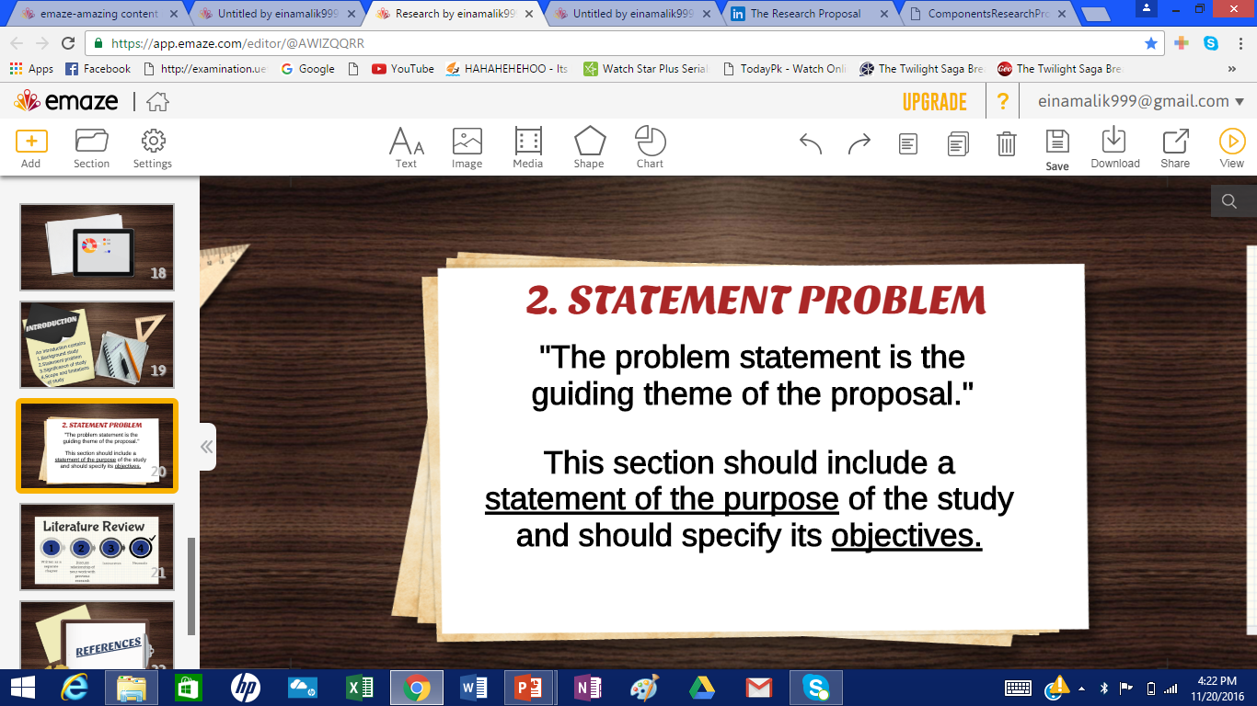

Slide 19
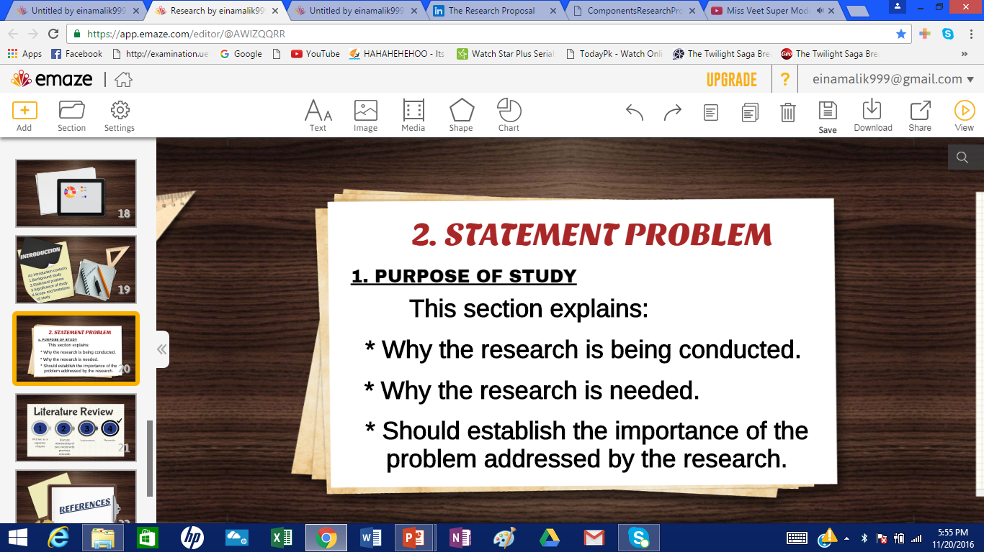

Slide 20
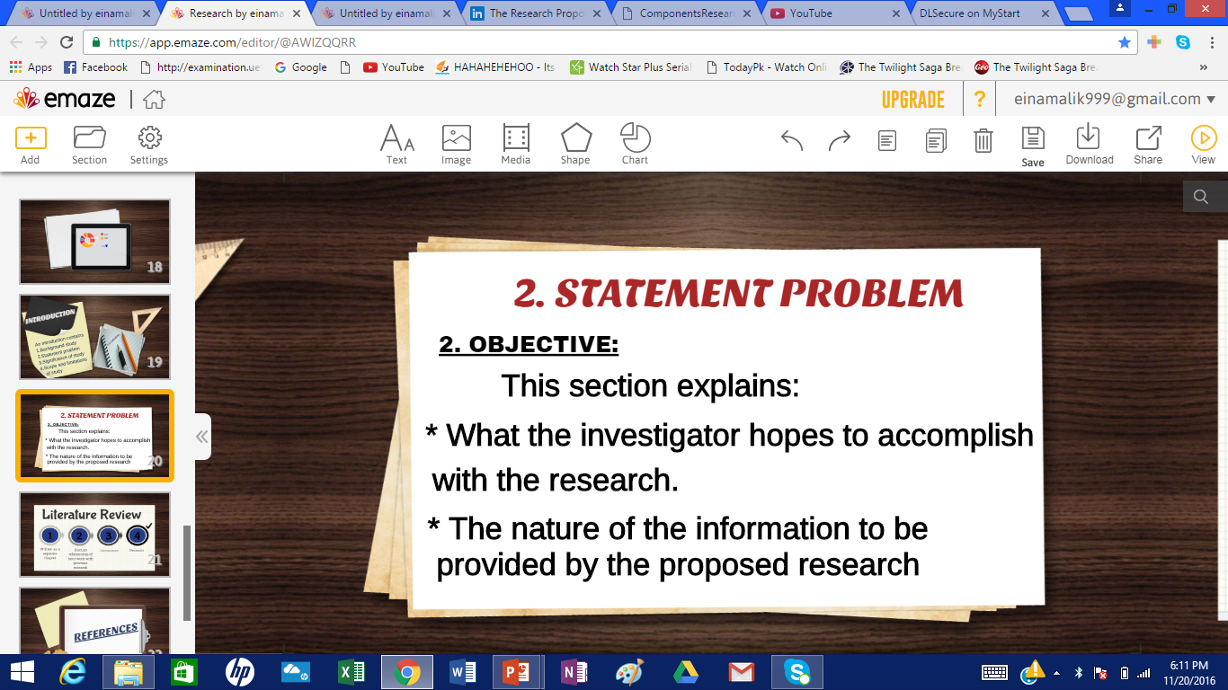

Slide 21
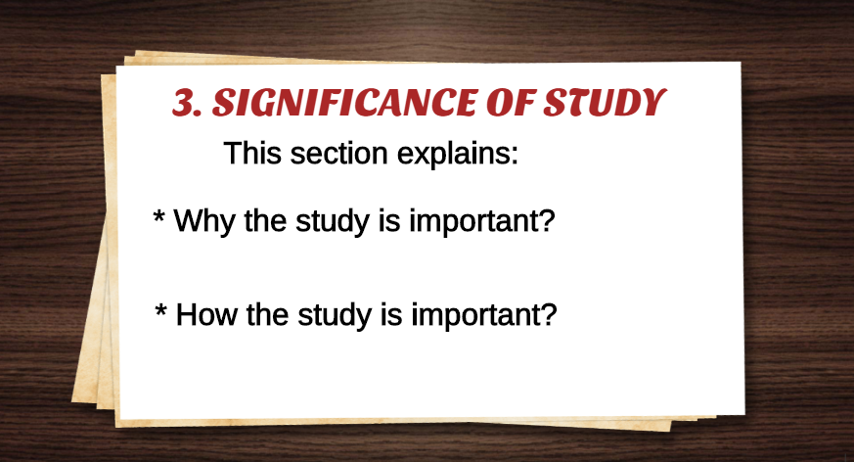

Slide 22
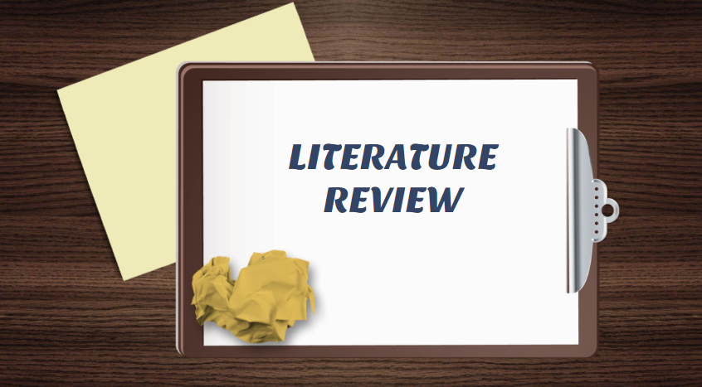

“A literature review is a survey and discussion of the literature in a given area of study.”

Slide 23


Slide 24
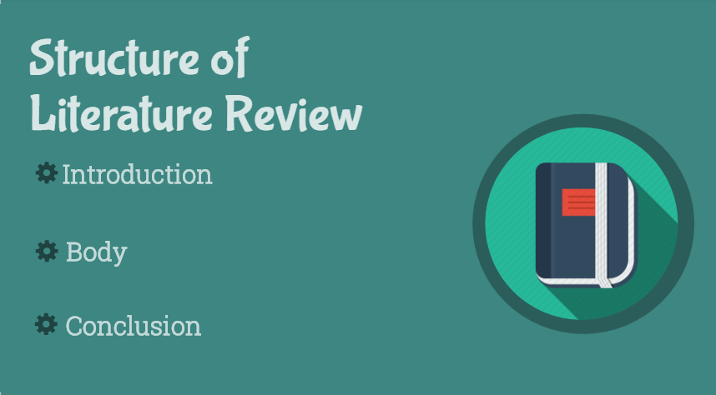

Slide 25
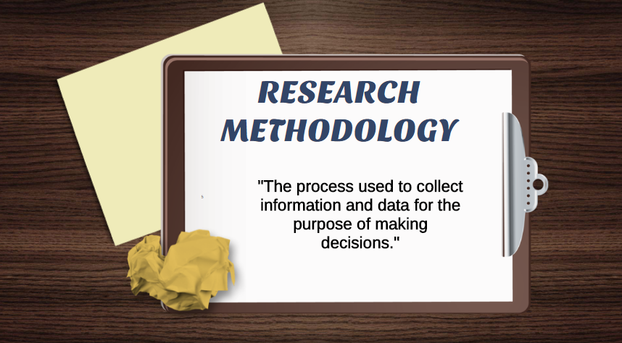

Slide 26
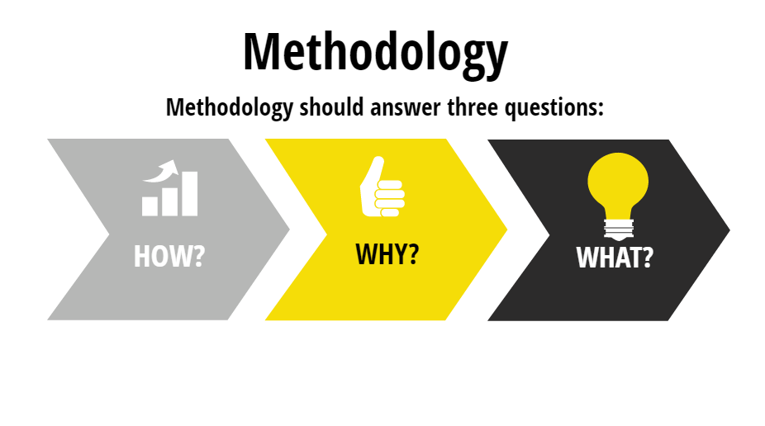

Slide 27
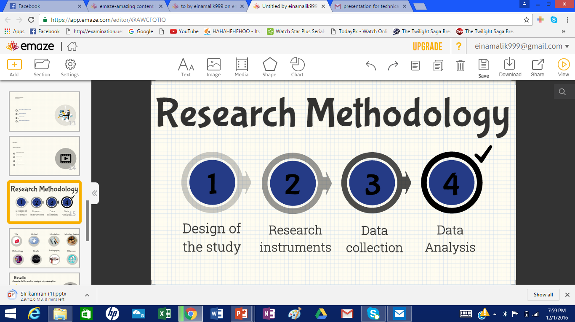

Slide 28
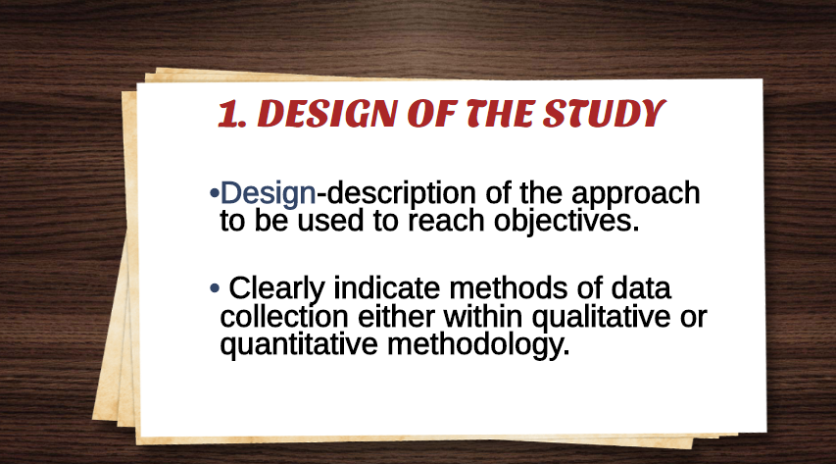

Slide 29
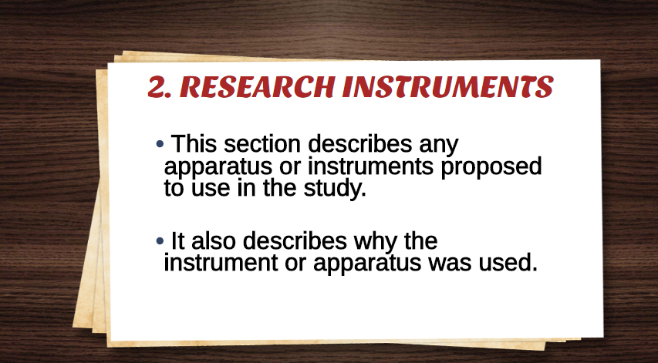

Slide 30
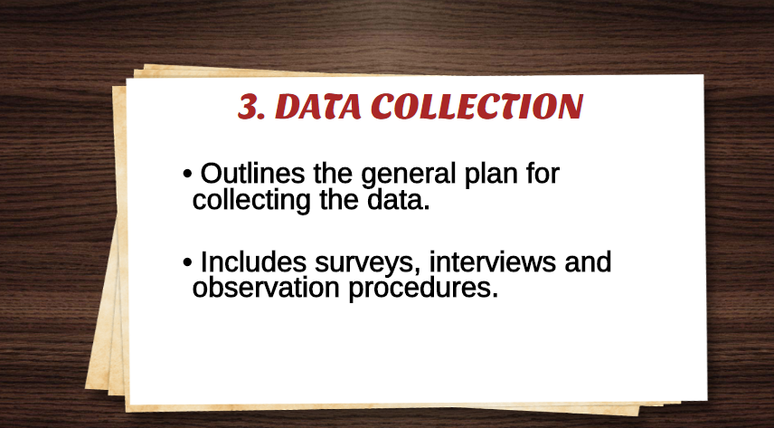

Slide 31
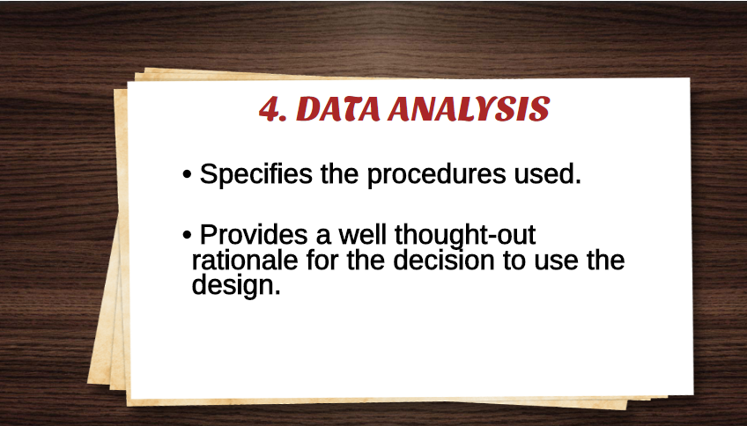

Slide 32
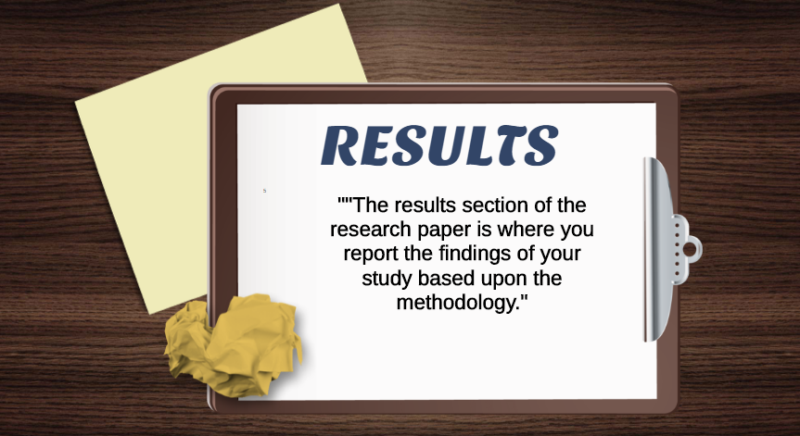

Slide 33
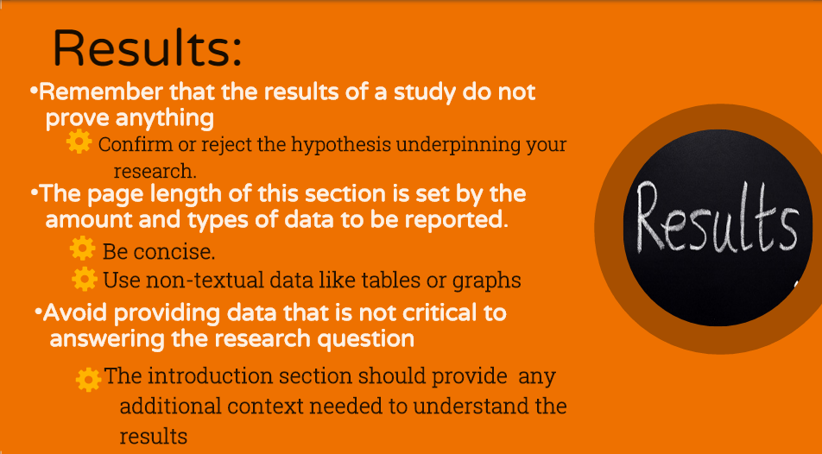

Slide 34


Slide 35
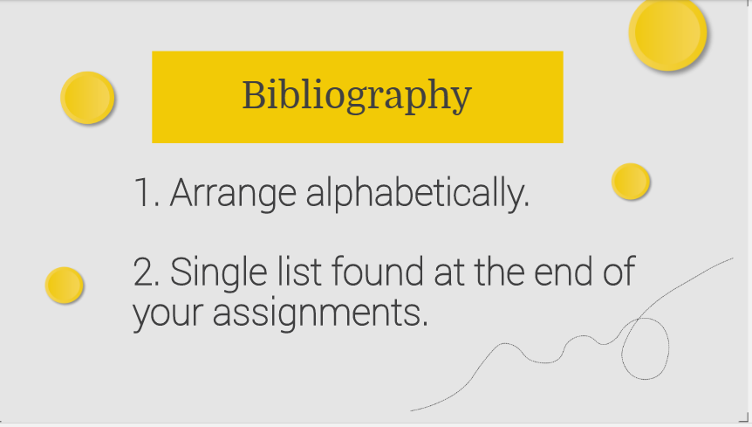

Slide 36
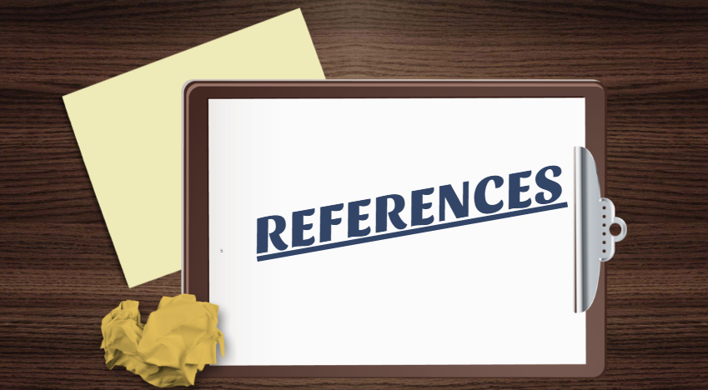

Slide 37
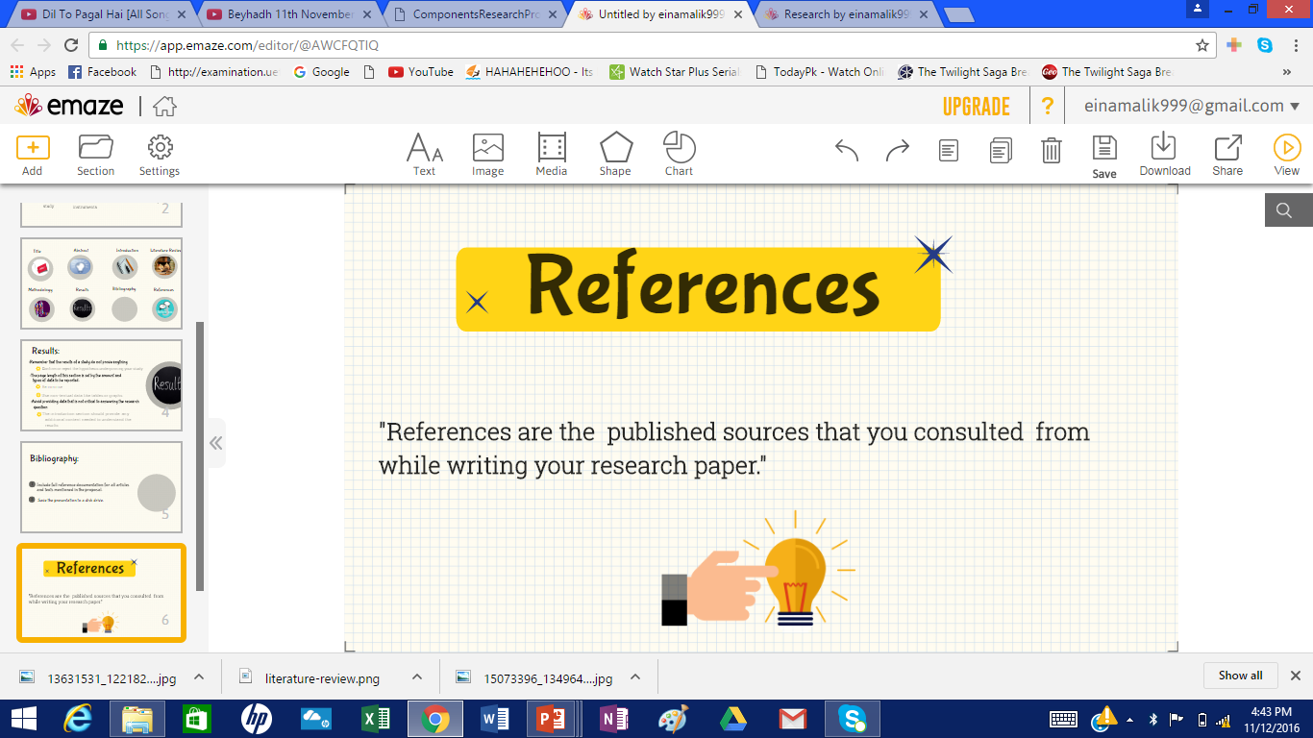

Slide 38
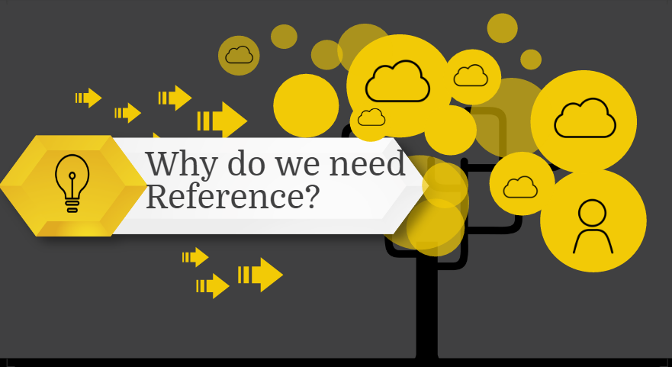

Slide 39
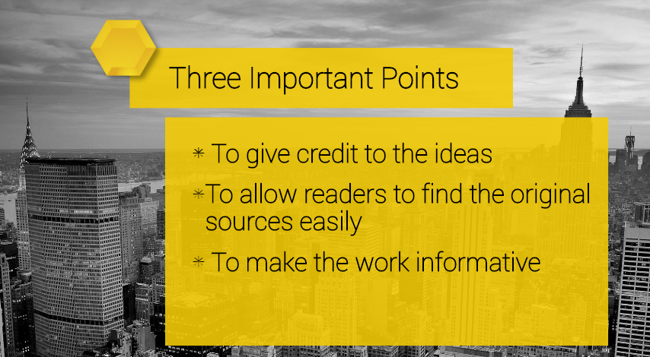

Slide 40
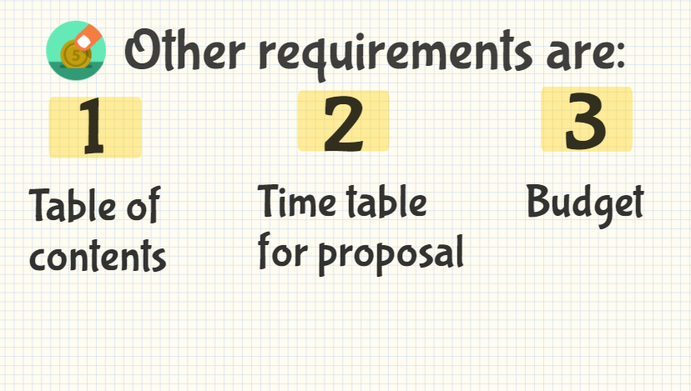

Slide 41
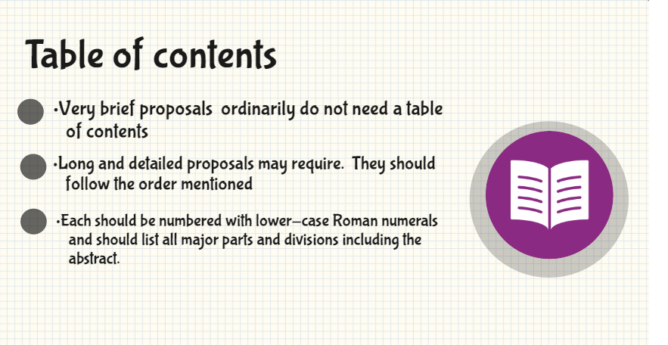

Slide 42
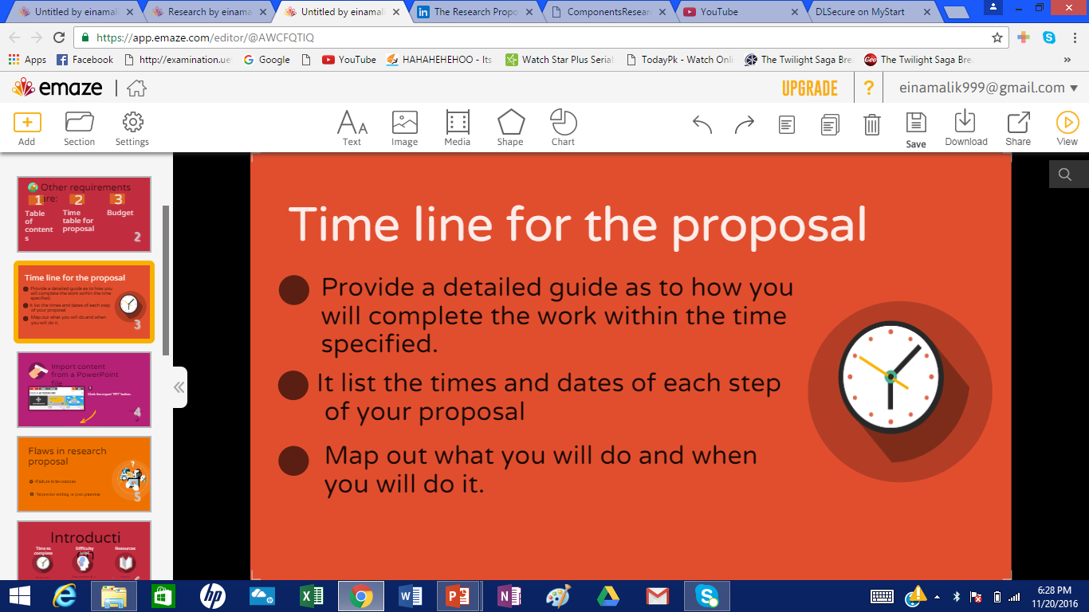

Slide 43
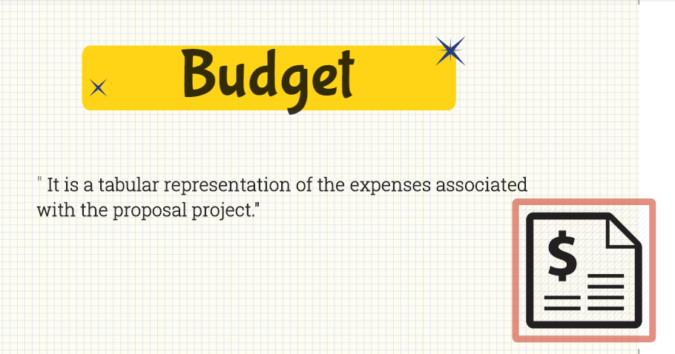

Slide 44
